Slide 1

Assistive Technology Solutions for Education
Dr. PiyuSh Chanana

Slide 2
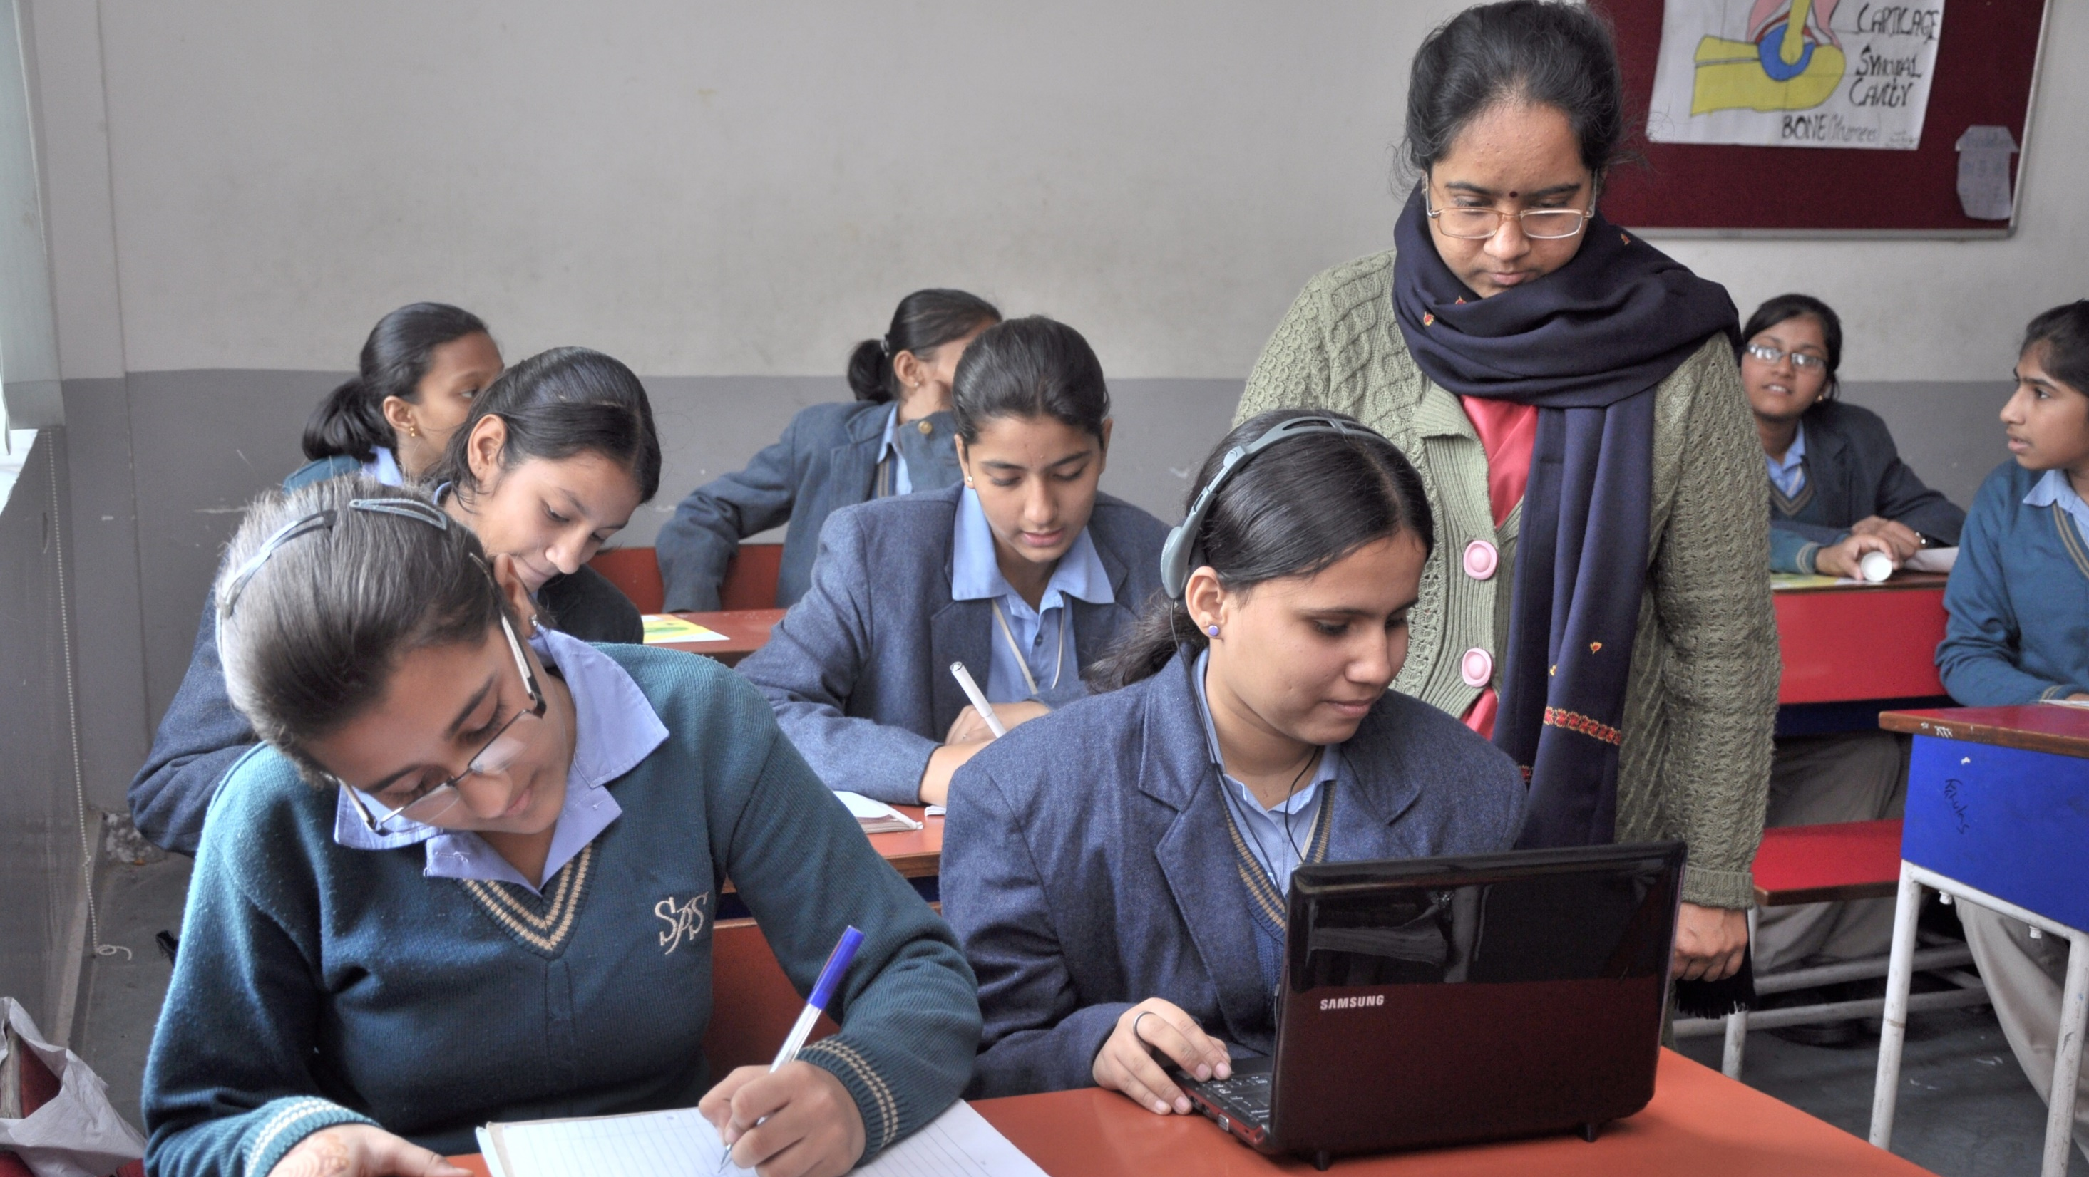
Inclusive Learning

Slide 3

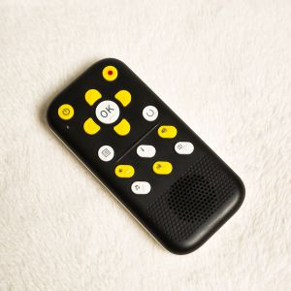
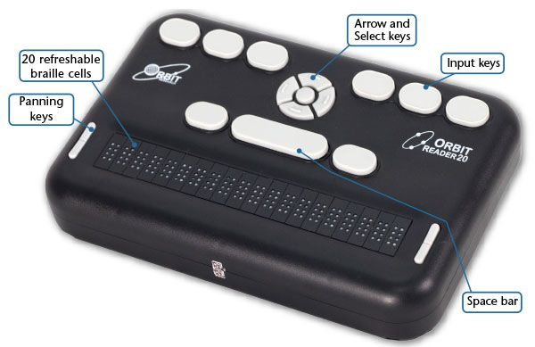
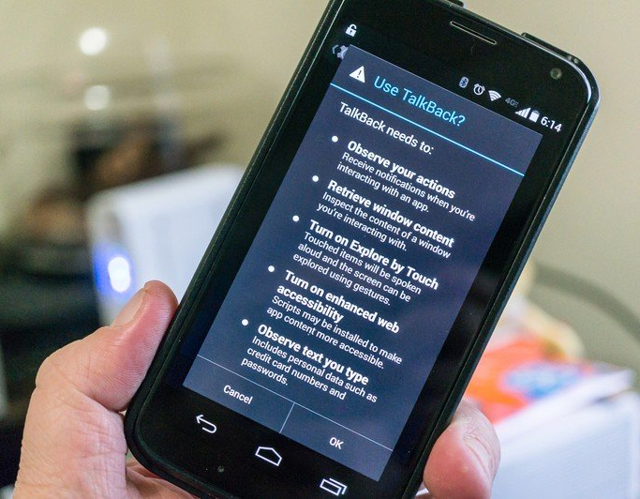
Assistive Technology Solutions
Affordability
Support for Indian Languages
Accessibility, high utility and user centric design

Slide 4
Computer (Windows- built in Accessibility features)
Low-vision
Text, mouse pointer, text colour, colour filters
Magnifier- Zoom in as per requirement
Blindness
Narrator- Built in screen reader
Voices, control volume speed, pitch, verbosity, contextual information
Captions
Mono audio, Display audio alerts visually, Notifications stick out for longer
Deaf or hard of hearing

Slide 5
Computer (Other Screen readers for Windows OS)
NVDA
Supports all Indian Languages,
Open Source
Indo-NVDA
Customized version of NVDA bundled with high quality human like voices
Available at an affordable price of approx. ₹ 3000
Unaffordable ($ 90 a year or $900 as one time purchase). Memory intensive
Quiet popular, works with Windows
JAWS

Slide 6
Computer Use
Apps for Reading
Thorium Reader, Kindle App
Browser- for exploring and reading content on webpages
Writing
Google docs, sheets
Word, Excel
Social Media- WhatsApp, Facebook, YouTube, Access phone with your phone
Calculator, Keep- for note taking
Utilities

Slide 7
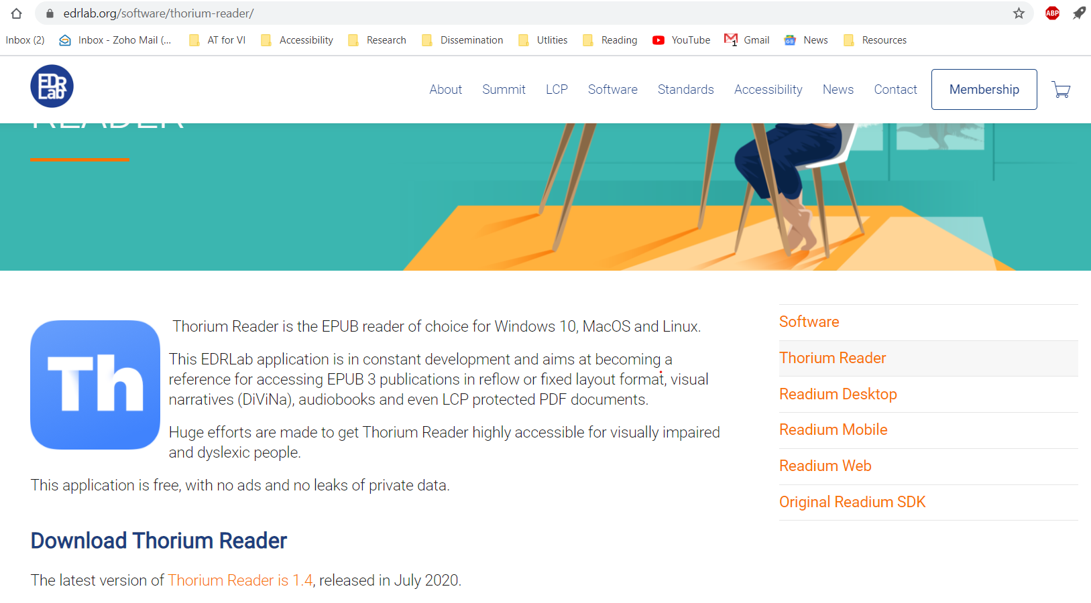
Thorium Reader for Reading on Computer

Slide 8
Smartphone and Tablet (Built in Accessibility features)
Low-vision
Display and font size, colour correction and inversion, cursor
Magnifier- Zoom in as per requirement
Blindness
Built in screen reader- TalkBack in Android and VoiceOver in iOS
Voices, control volume speed, pitch, verbosity, contextual information
Captions
Mono audio, Audio balance, Haptic feedback
Deaf or hard of hearing

Slide 9
Smartphone or Tablet Use
Communication
Calling, Messaging, WhatsApp
Social Media, Email
Reading
Book Reading in Indian Languages- Simply Reading, Kibo etc.
Browser- for webpages, news, documents etc.
Physical Keyboard for fast writing, navigation and controlling the phone
Google Keep- Note taking in Indian Languages
Writing

Slide 10
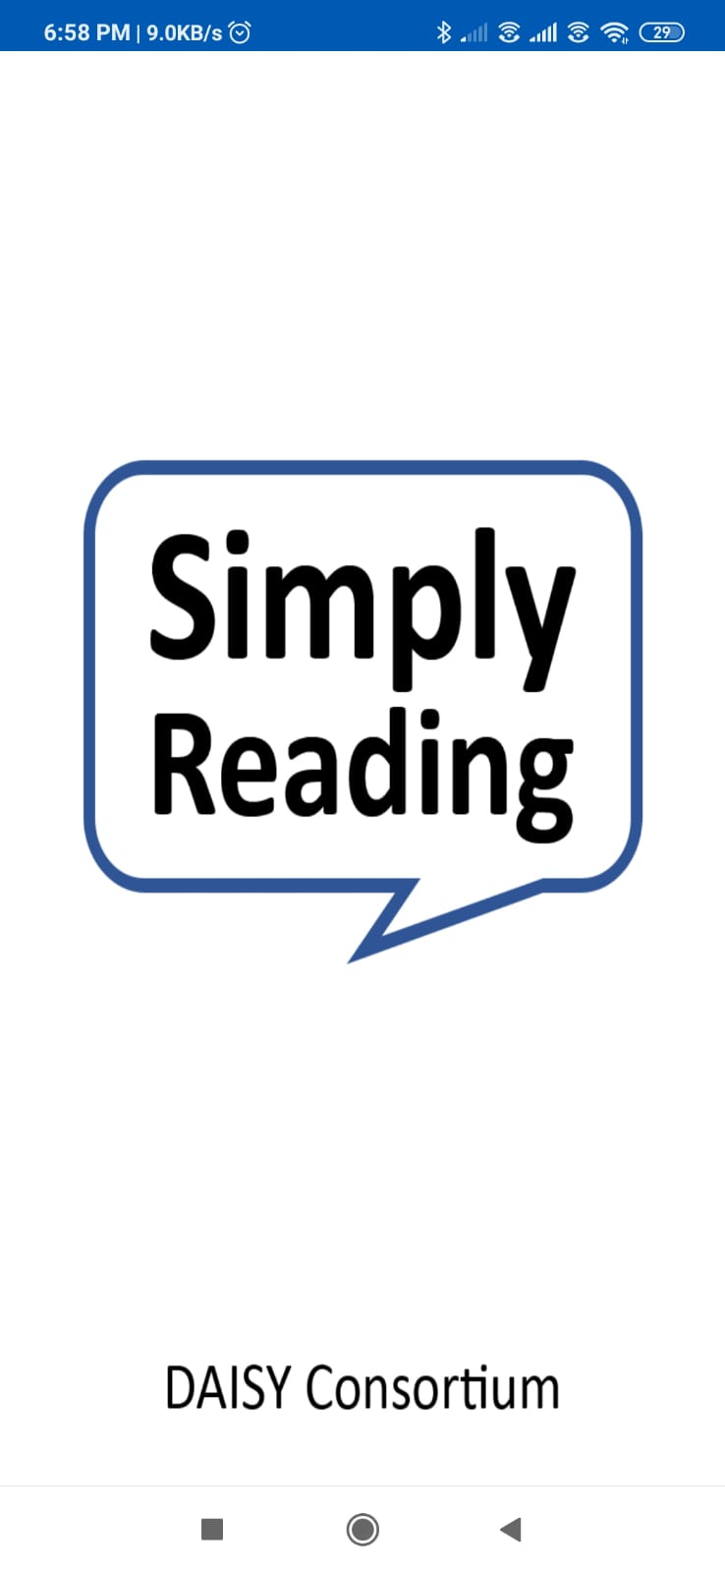
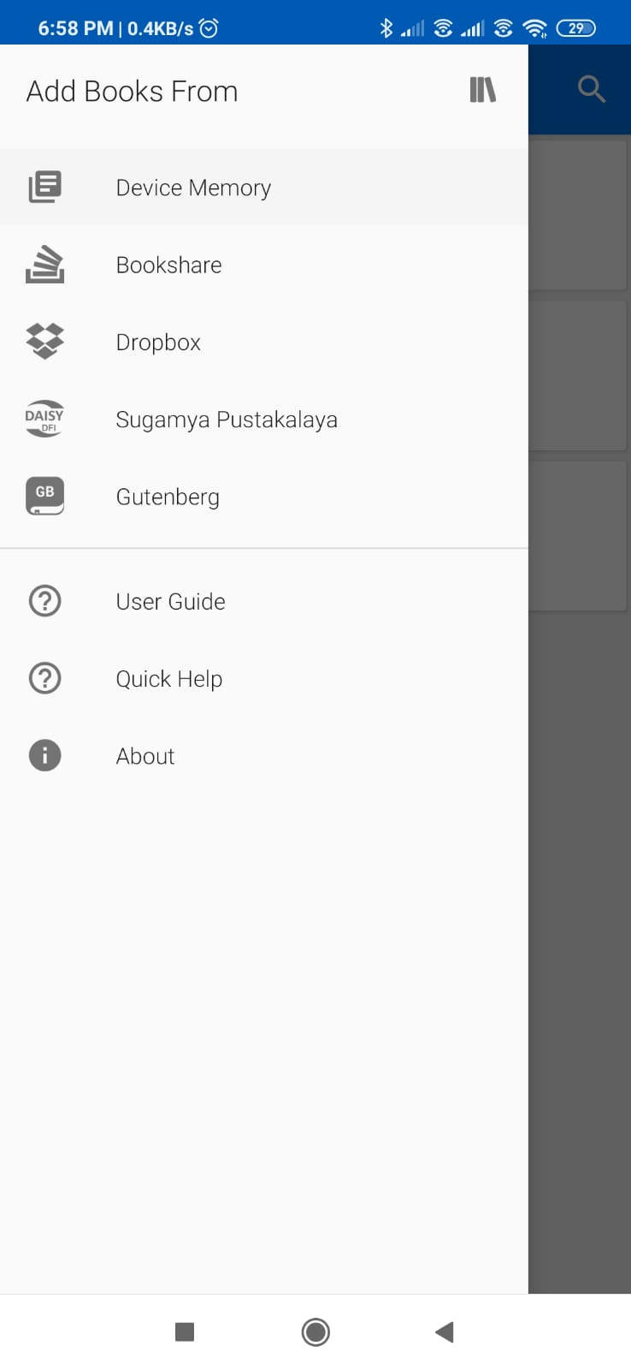
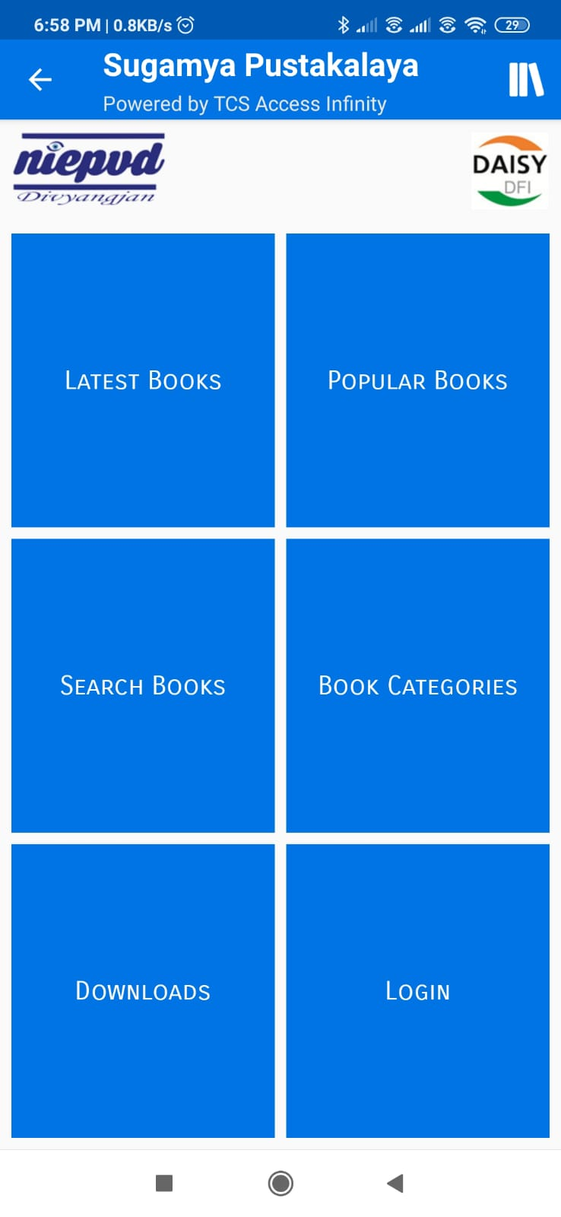
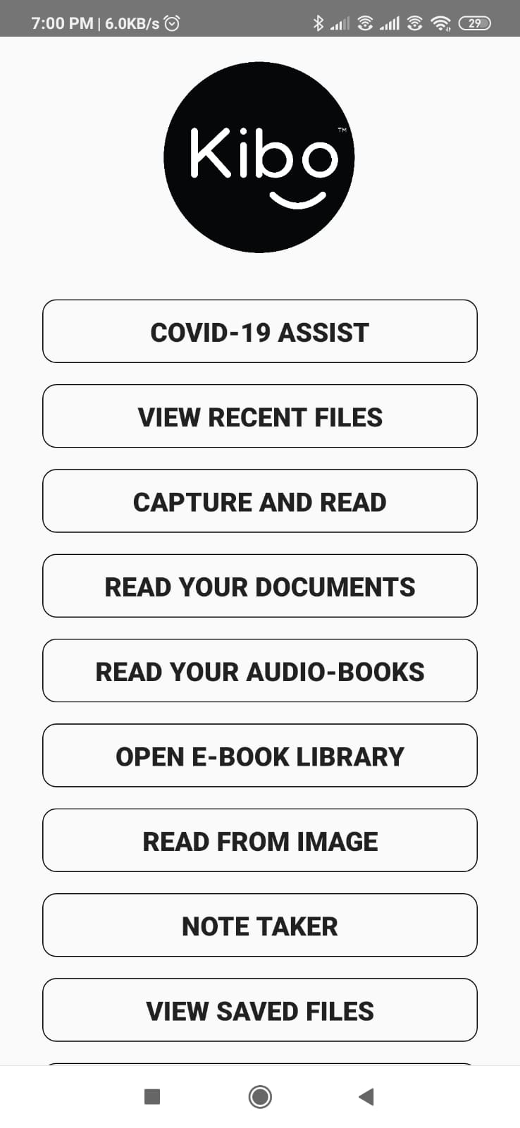
Smartphone apps for reading

Slide 11
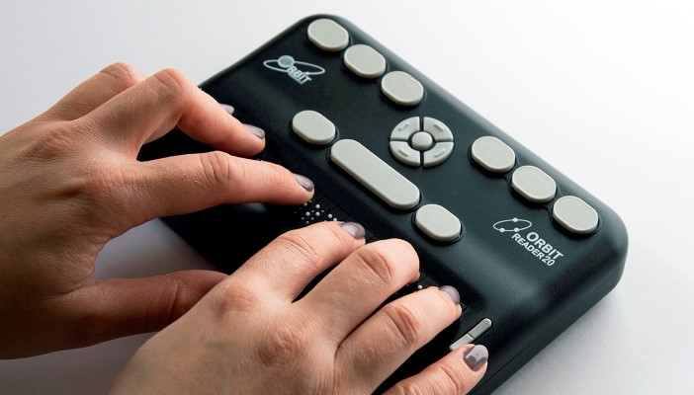
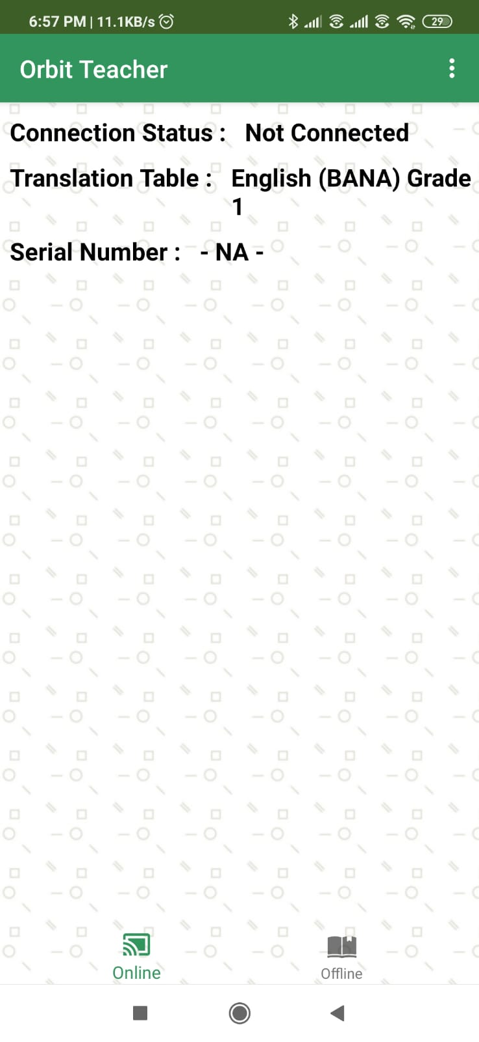
Electronic Braille Display

Slide 12
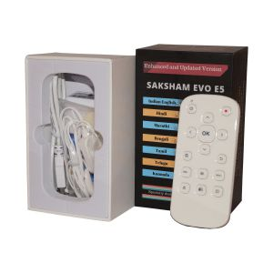
DAISY Player
Audio recording
Can read and playback text files
Support for multiple Indian languages with rich navigation features
Direct connectivity on online libraries through Wi-Fi

Slide 13
Braille Display

Slide 14
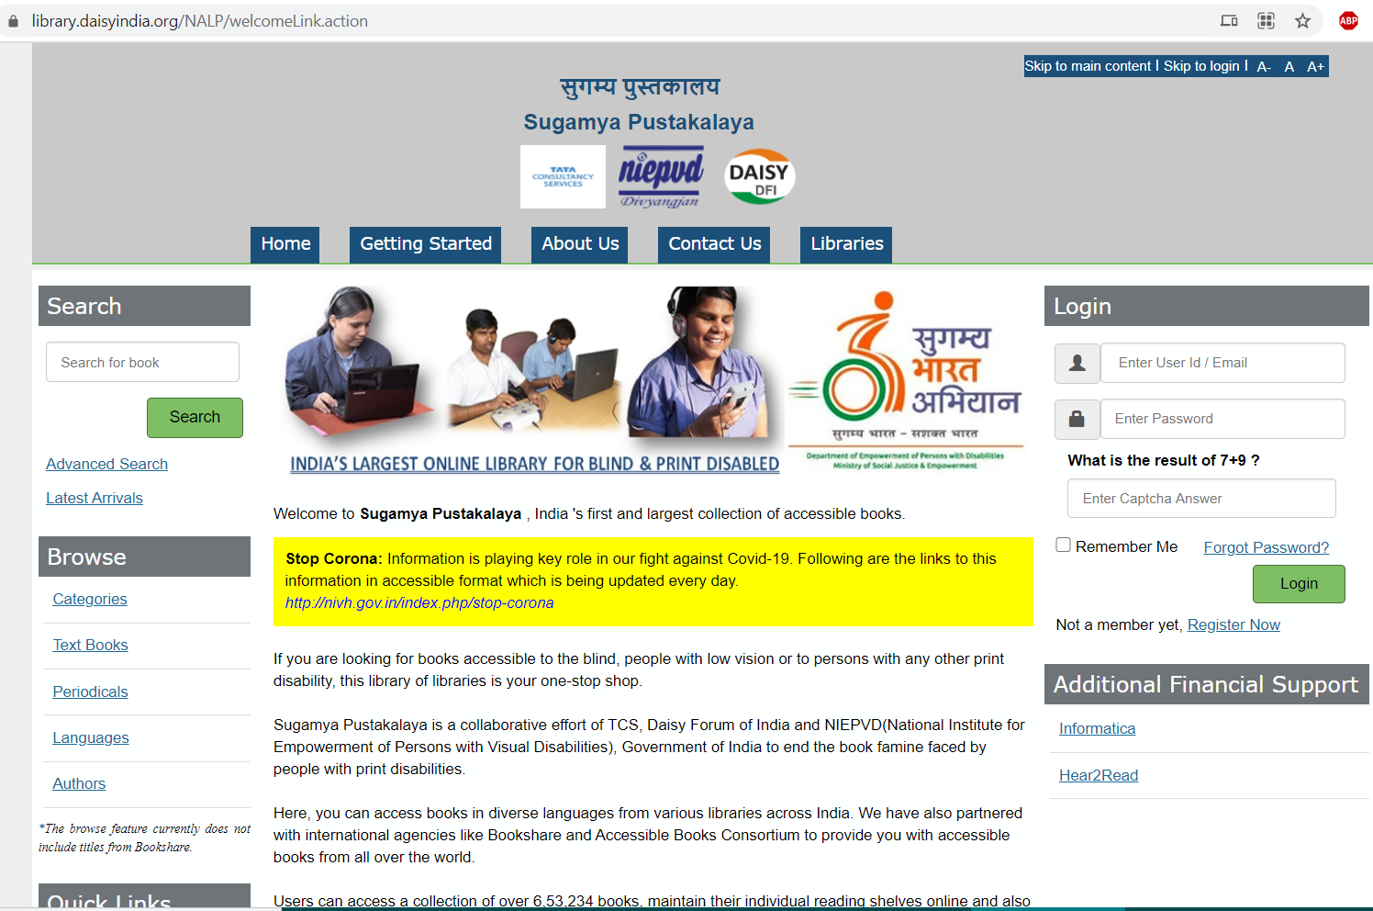
Sugamya Pustakalaya (library.daisyindia.org)
Collection of lakhs of accessible books
Membership free for persons with print disabilities
200+ organizations part of it and contribute content not only in English but other Indian languages also

Slide 15
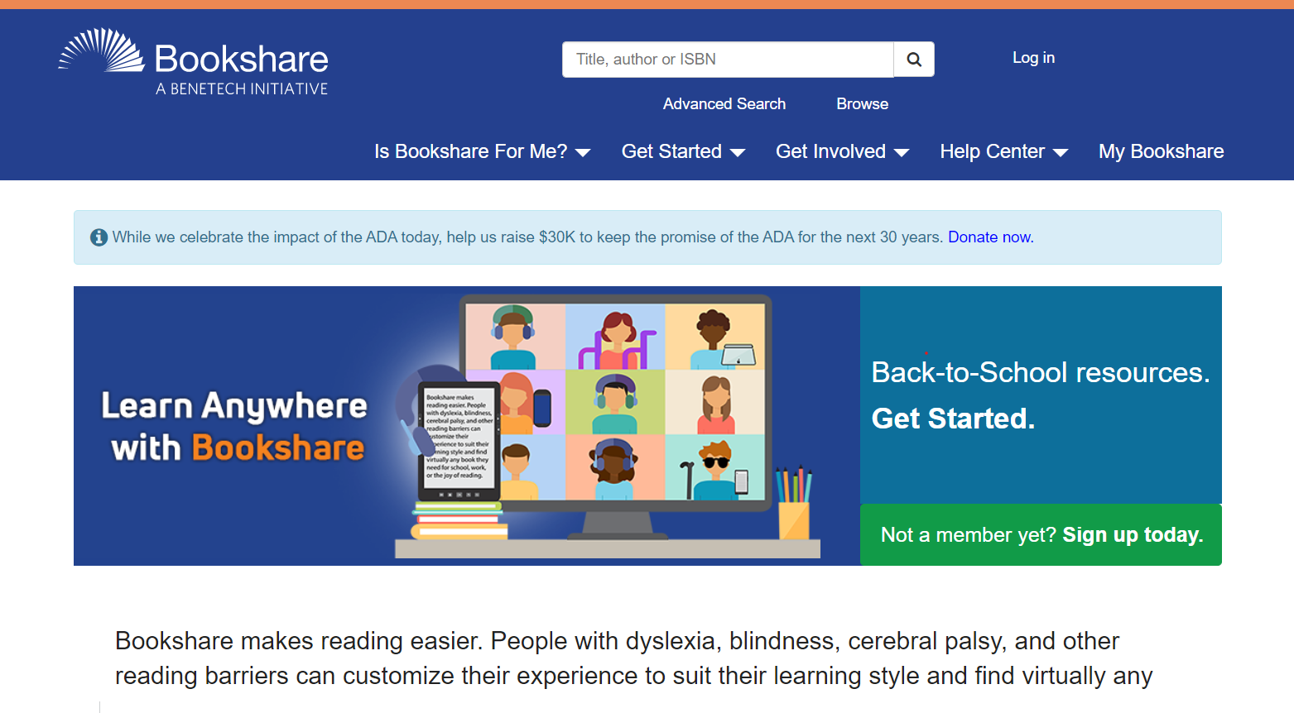
Bookshare

Slide 16
Contact:
Piyush Chanana
piyush.chanana@gmail.com,
7065733734

